Slide 1
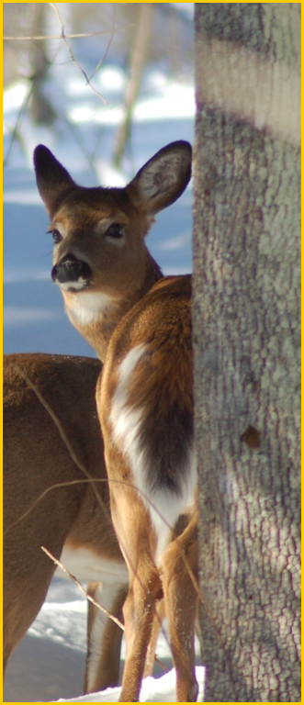
New Brunswick
Deer Population
Overview
Sackville, New Brunswick
March 2, 2022
Joe Kennedy
Deer Biologist
Natural Resources and Energy Development

Slide 2
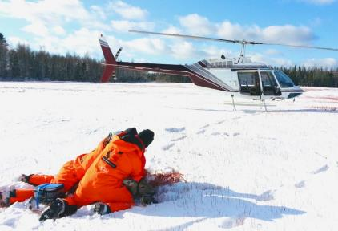
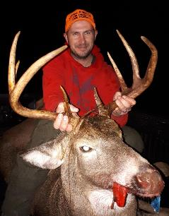
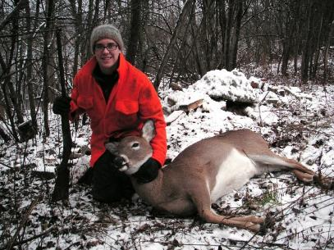
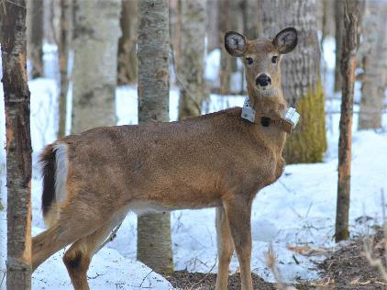
OVERVIEW
1) Current deer harvest numbers and buck age structure
2) WMZ 25 & 24 Trends and Future
3) Brief look at UNB deer research

Slide 3
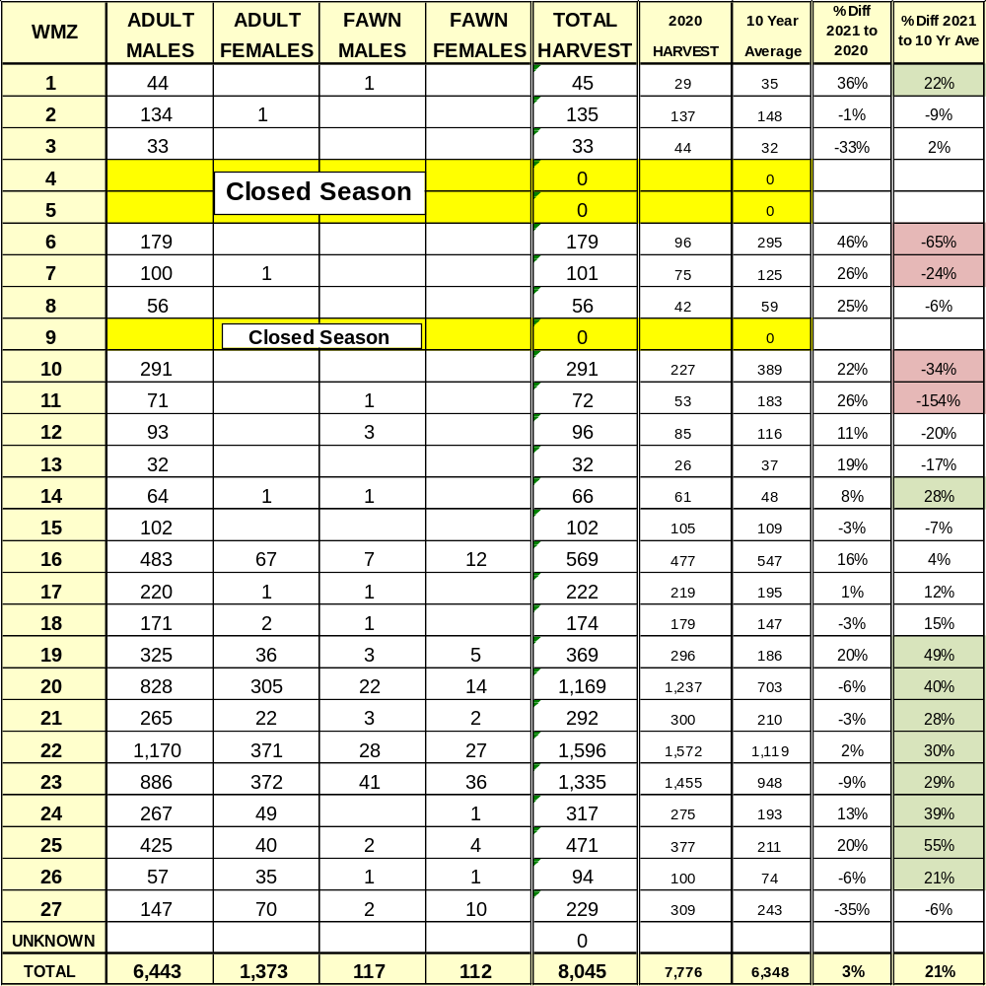
2021 NB DEER HARVEST

Slide 4
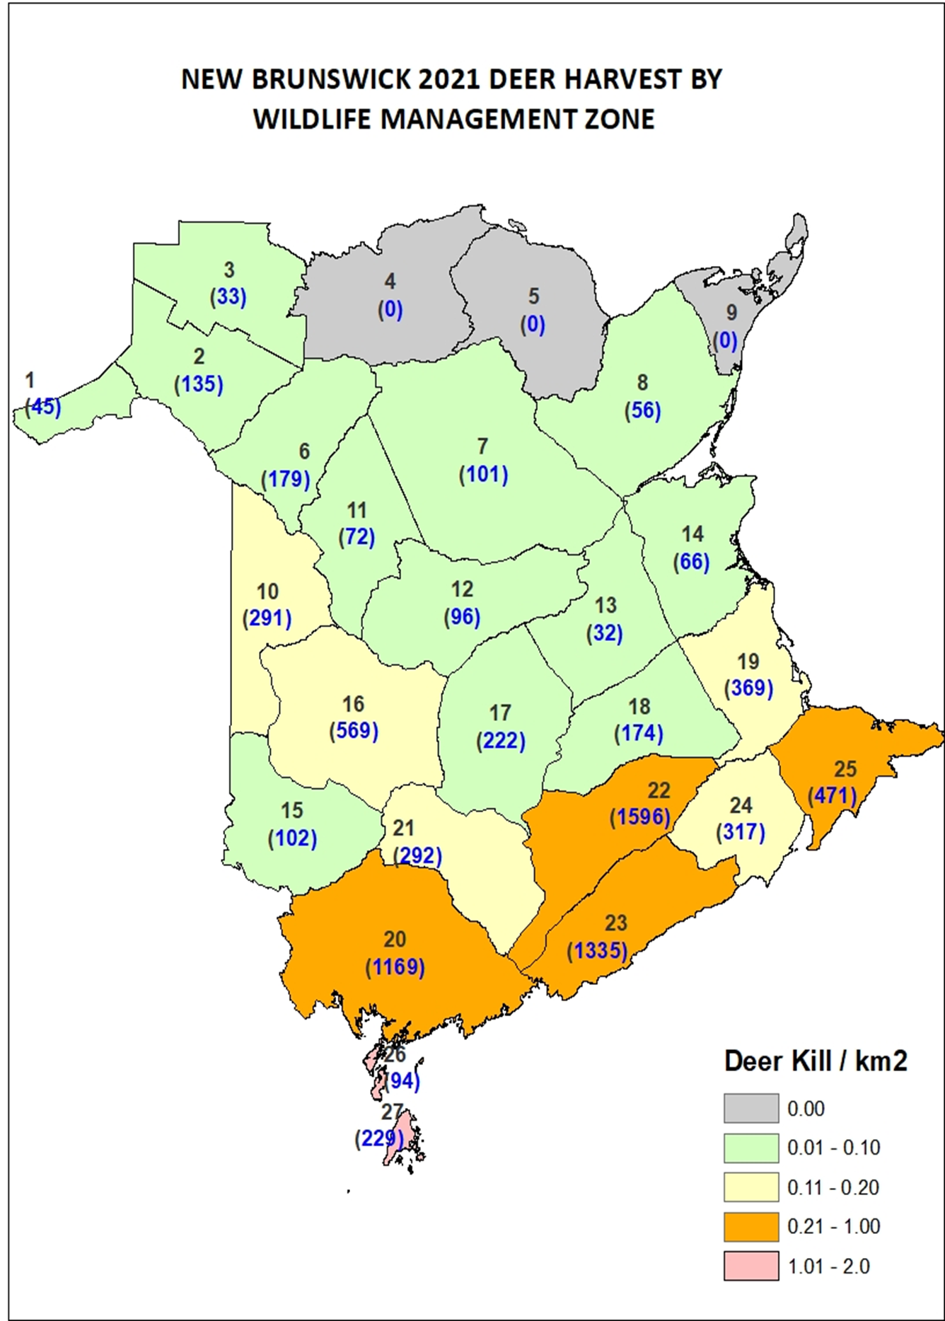

Slide 5
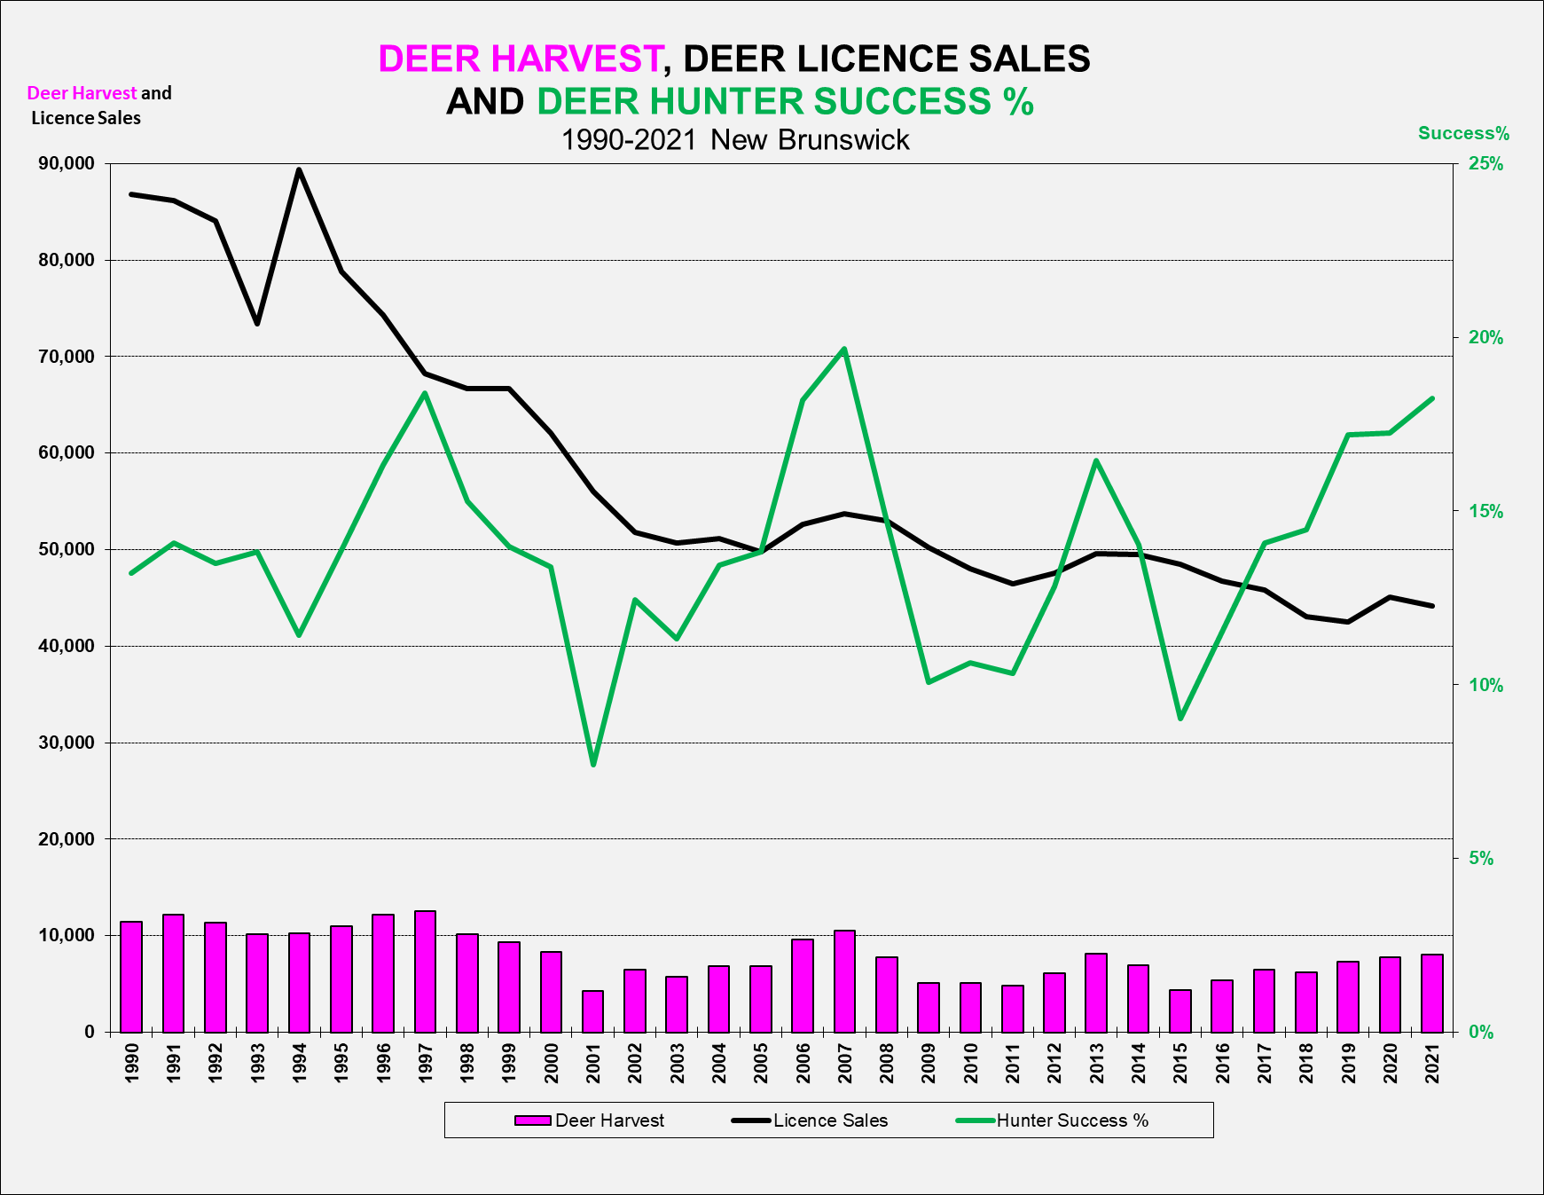

Slide 6
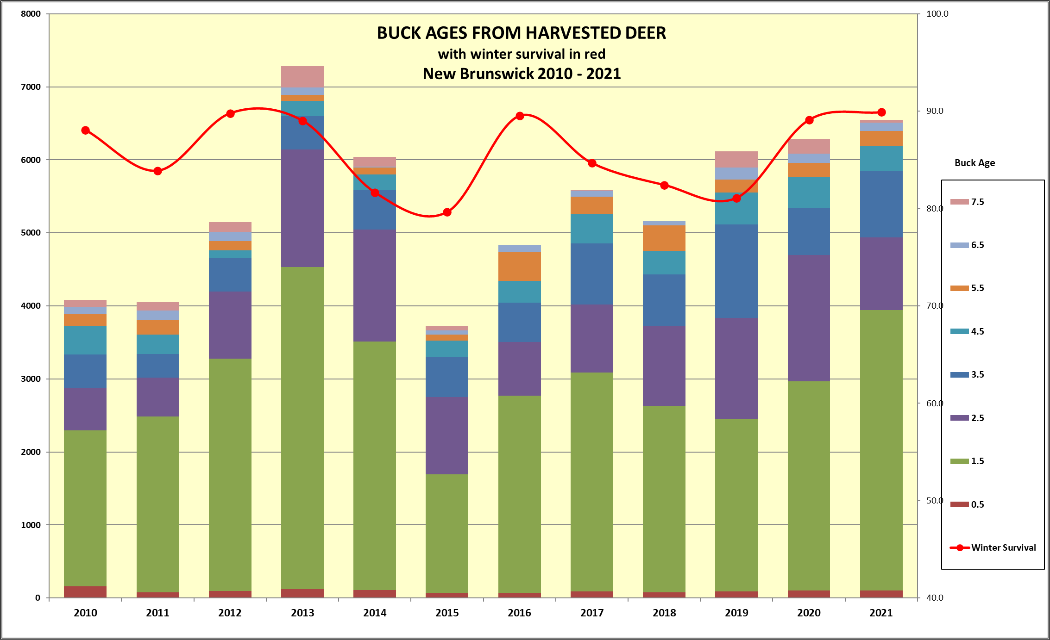

Slide 7
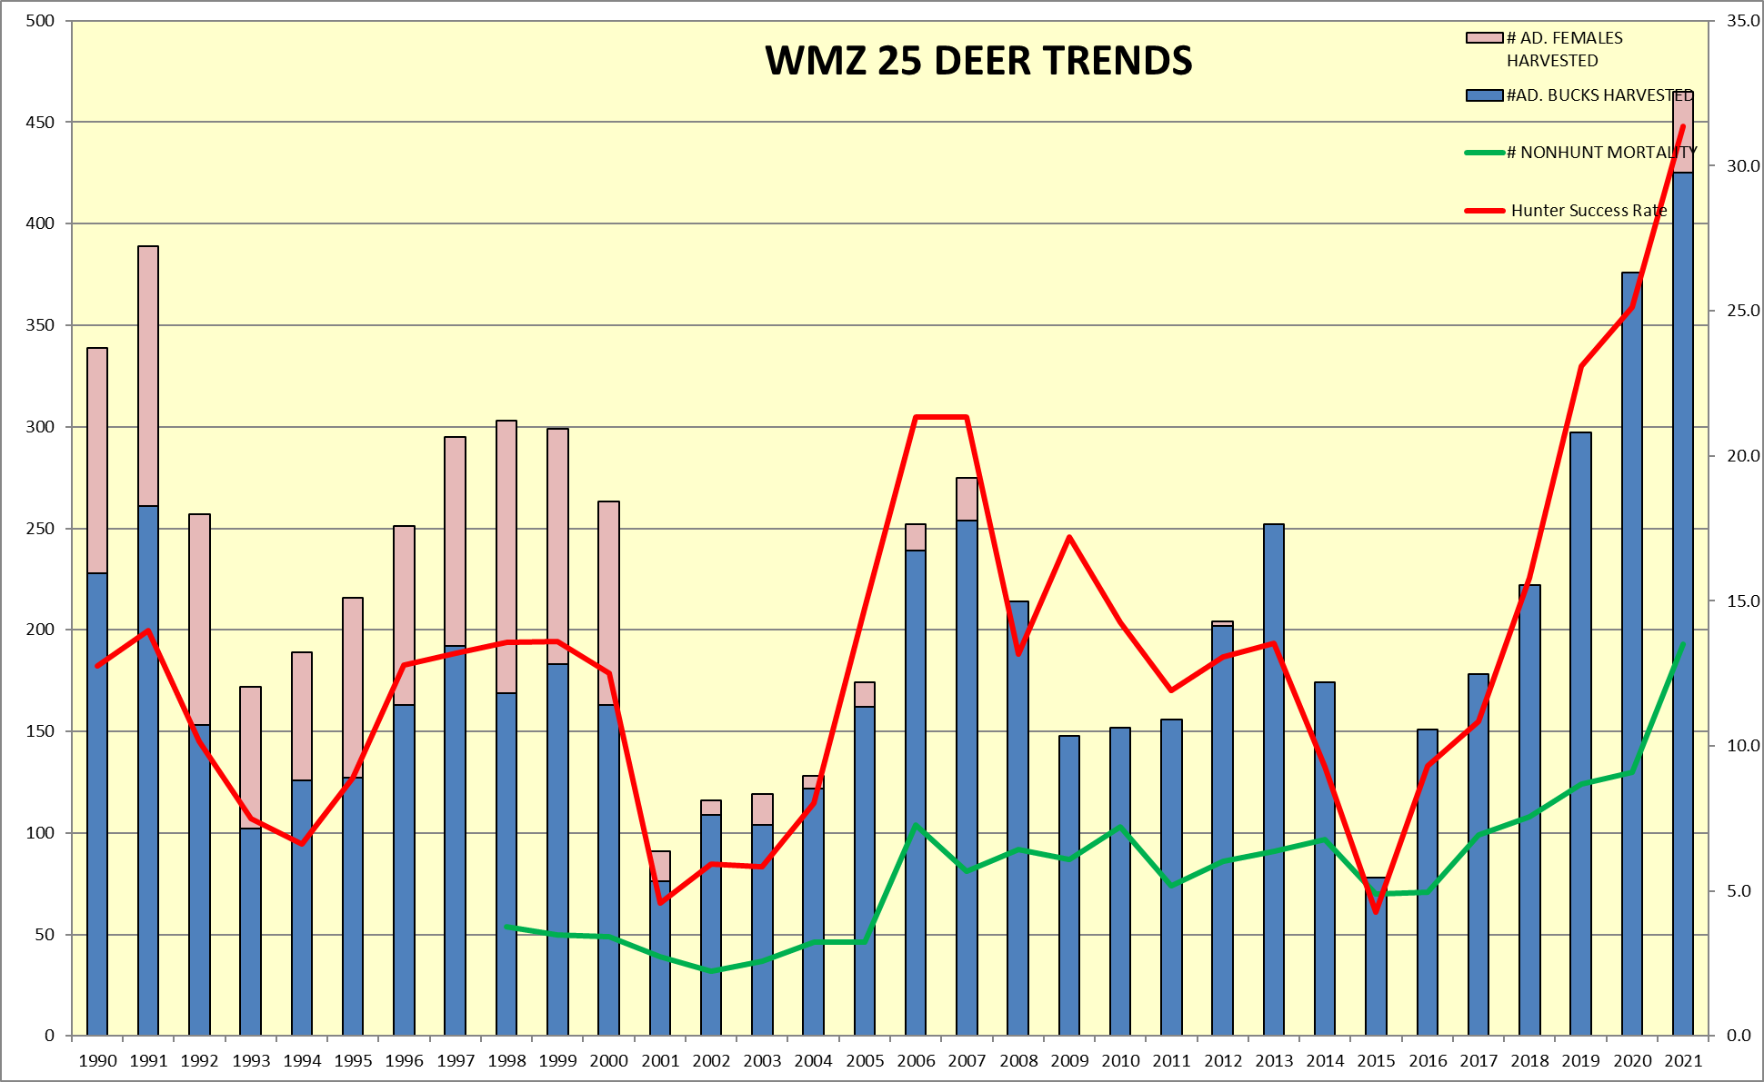

Slide 8
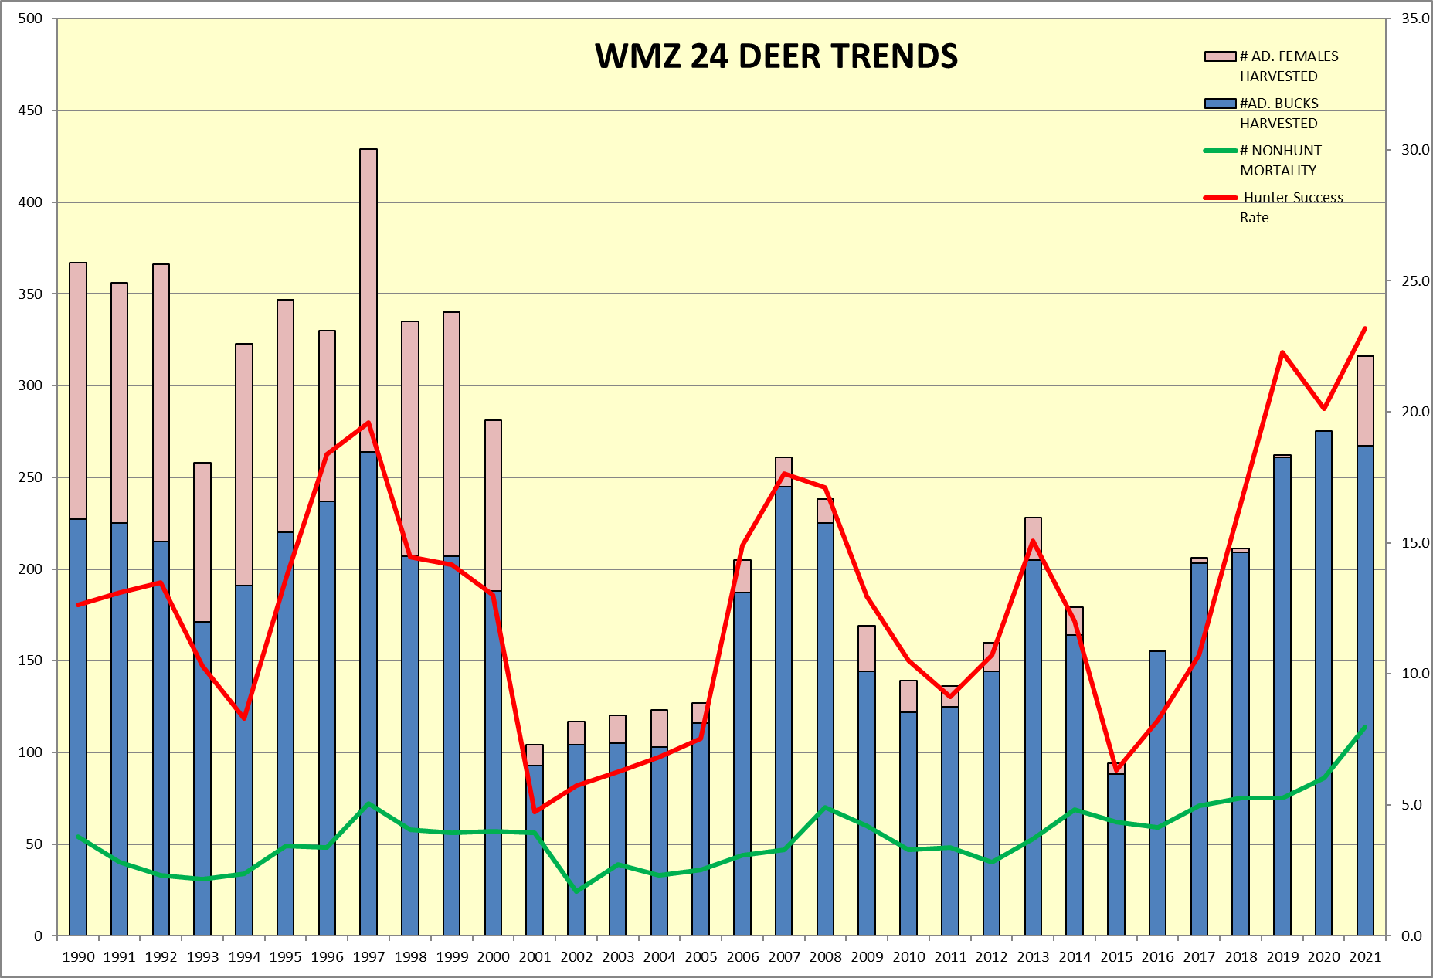

Slide 9
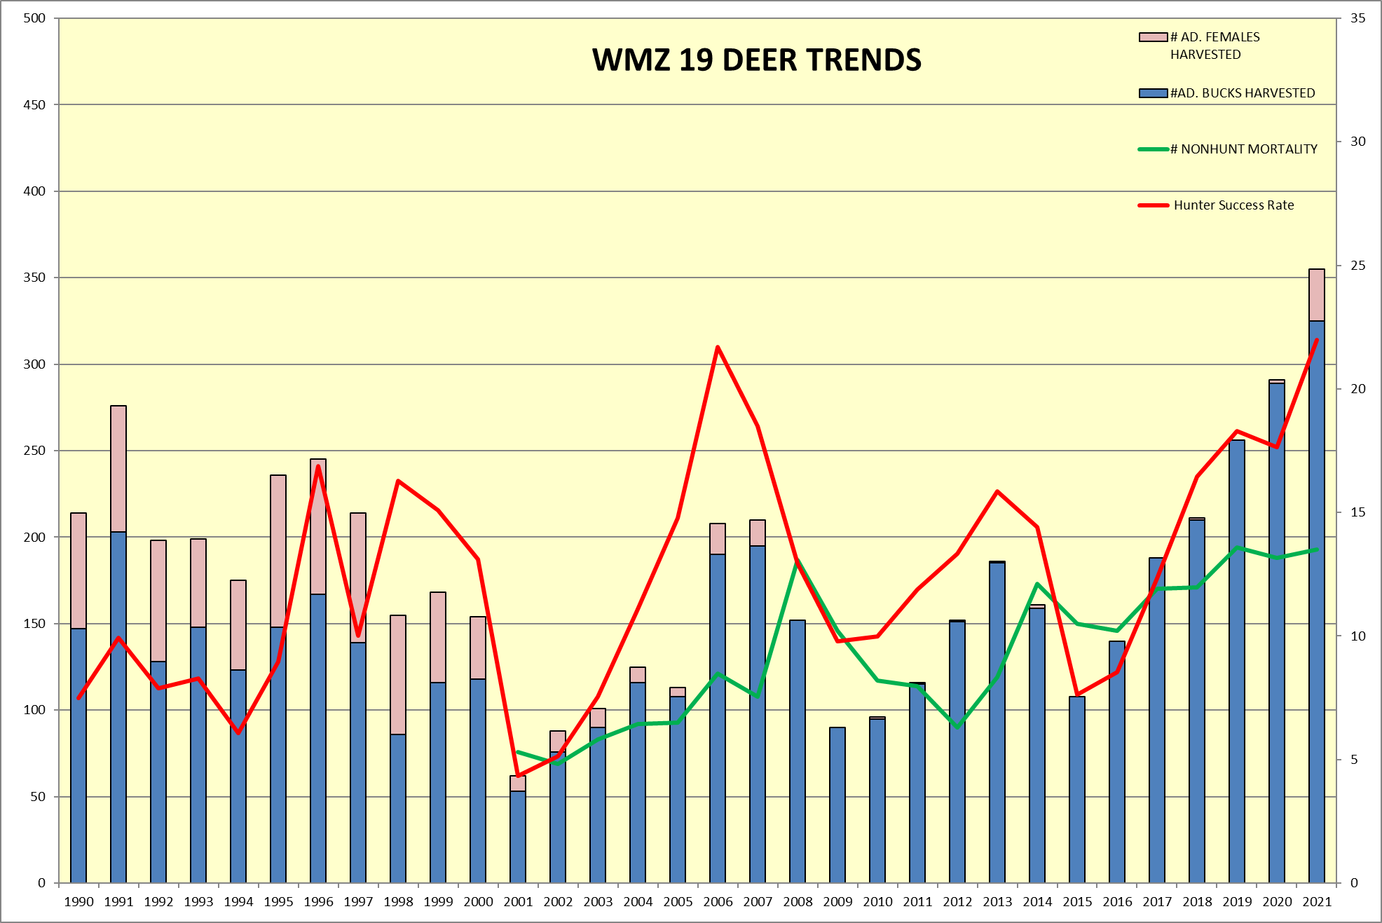

Slide 10
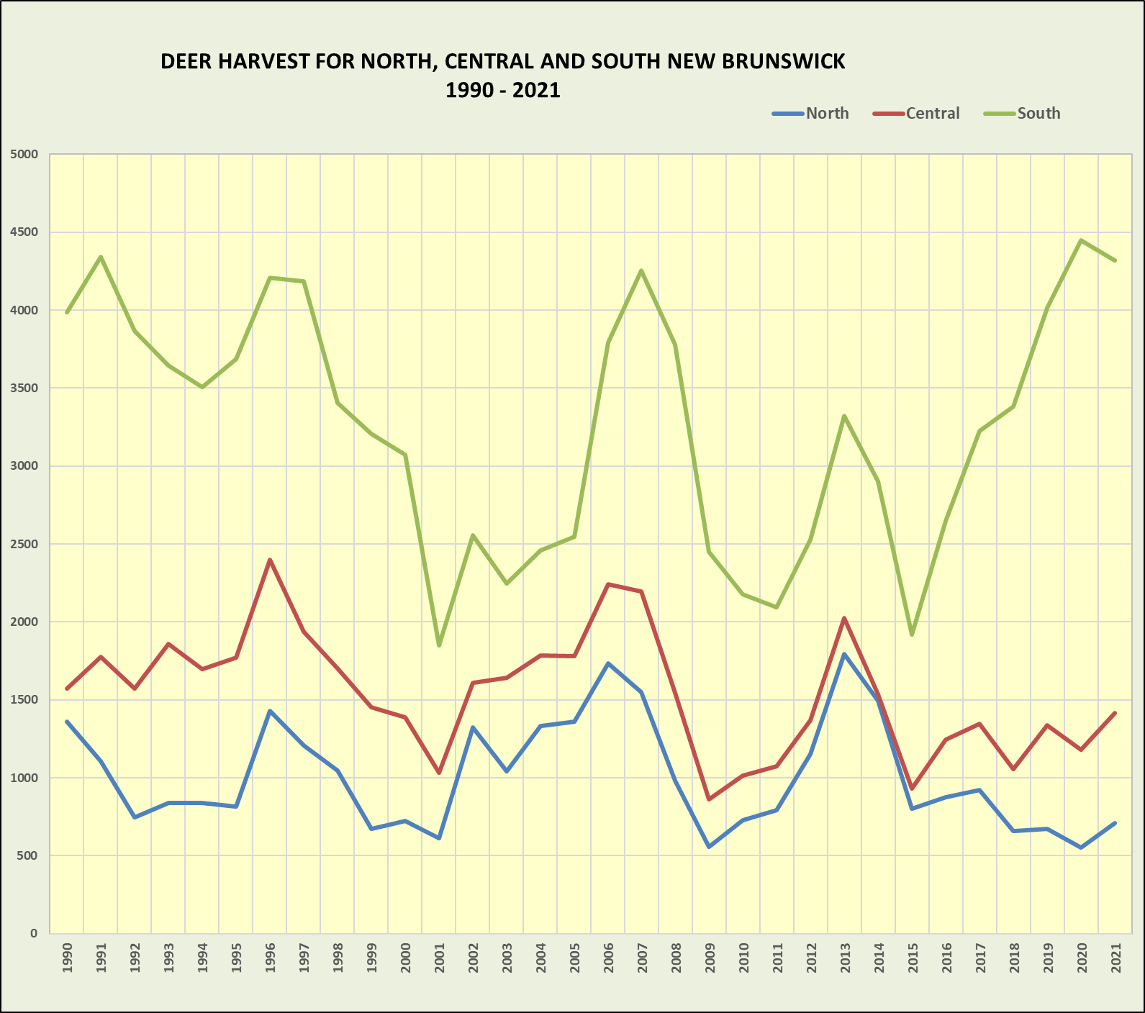

Slide 11

UNB / DNR DEER RESEARCH PROJECT
Examine 1) deer habitat use and 2) survival.
Compare intensively managed land, crown land, and private lands in north and south NB for both deer habitat use and survival.
Examine deer food availability in clearcuts, plantations, thinnings, and herbicided sites over time.
PhD research (Phil Weibe) started in 2016. Field work is completed, and final report is expected in 2022.
The funding is primarily from NSERC, with support from UNB, ERD, CFS and JD Irving.
A joint study is occurring in Maine, with cooperation from UM, UNH, Maine Fish and Wildlife.

Slide 12
2022 FOR DEER???
If winter continues to be mild, we’ll likely see an increase in deer numbers, and increased antlerless deer permits.
Minister will be announcing more details on increased hectarage of Conservation Forest and Deer Wintering Areas.
UNB deer research report should be available, and DNRED will consider how to incorporate findings into management plans.
Will continue with nuisance deer management in urban and agricultural lands.

Slide 13
